Slide 2
Logistics
Wednesdays @5:30pm
Rotating speakers?
Topics:
Recursion
Space and Runtime Complexity Analysis
Data Structures – {Linked Lists, Maps, Stacks, Queues, Graphs, Trees}
Algorithms

Slide 3
What is recursion?
When a function calls itself over and over again

Slide 4
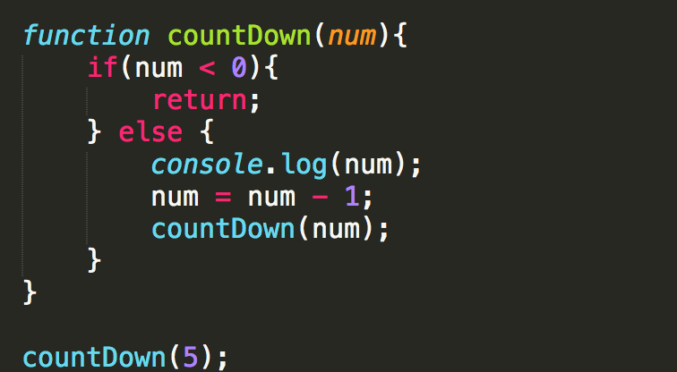
What is recursion?
When a function calls itself over and over again

Slide 5
What is recursion?
When a function calls itself over and over again
Base Case(s)
Terminate it!
Recursive Case
Make more function calls.

Slide 6
Fibonacci Sequence
0, 1, 1, 2, 3, 5, 8, 13, 21, 34, 55, 89, …
Given a number n, find the corresponding value in the Fibonacci sequence.
n = 4, => return 3;
n=10, => return 55;

Slide 7
Fibonacci Sequence
0, 1, 1, 2, 3, 5, 8, 13, 21, 34, 55, 89, …
Given a number n, find the corresponding value in the Fibonacci sequence.
n = 4, => return 3;
n=10, => return 55;
How can we implement this?
*Assume we’re starting with n=0
*NOTE: Indices start at 0, not 1

Slide 8
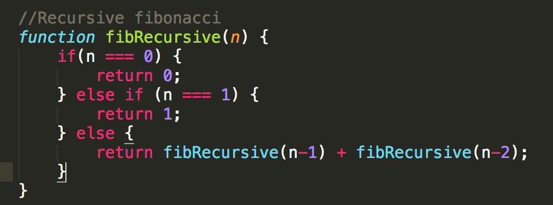
With Recursion

Slide 9
Parts of a Recursive Solution
Base Case(s)
Check to see if you are finished with recursion, and begin to return.
Recursive Case
Make more function calls.

Slide 10
What is happening internally?
For example, if we called fibRecursive(5)
1
fibRecursive(5)
2
fibRecursive(3)
fibRecursive(4)
3
fibRecursive(1)
fibRecursive(2)
fibRecursive(2)
fibRecursive(3)
4
fibRecursive(0)
fibRecursive(1)
fibRecursive(0)
fibRecursive(1)
fibRecursive(1)
fibRecursive(2)
Return 1
Return 0
Return 1
Return 0
Return 1
Return 1
Return 1
Sum = 5

Slide 11
What the Interpreter Does
fibRecursive(3)
fibRecursive(3) + fibRecursive(2)
fibRecursive(2) + fibRecursive(1) + fibReursive(1) + fibRecursive(0)
fibRecursive(1) + fibRecursive(0) + 1 + 1 + 0
1 + 0 + 1 + 1 + 0

Slide 12
Recursive Stack
Each sub-call runs independently.
That information is in the recursive stack!
Implications:
Must all be in the SAME stack. Otherwise it loses that information and cannot reconstruct your answer.

Slide 13
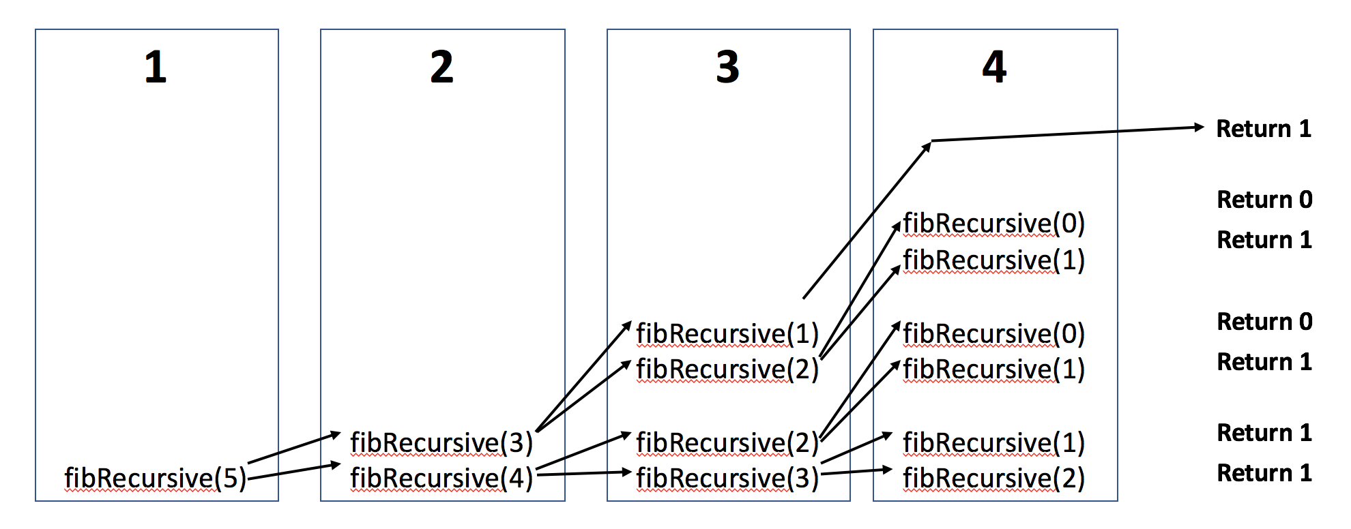
How could we improve this?
What if the recursive stack didn’t get bigger at each step?

Slide 14
How could we improve this?
What if the recursive stack didn’t get bigger at each step?
In ES6, the interpreter will reuse the stack frame instead of creating a new one if…:
The LAST thing the function does before returning is a function call,
The next recursive function call does not need access to any current local variables,
And if the interpreter does not need to remember how to reconstruct your answer

Slide 15
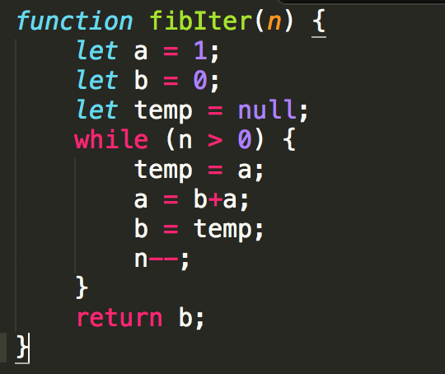
Iterative Implementation?

Slide 16
Iterative Implementation?
Pretend as if we’re walking along a list of fibonacci numbers until we reach the terminating condition.
fibIter(3)
@n=3: a=1, b=0
@n=2: a=1, b=1
@n=1: a=2, b=1
@n=0: a=3, b=2
fibIter(5)
@n=5: a=1, b=0
@n=4: a=1, b=1
@n=3: a=2, b=1
@n=2: a=3, b=2
@n=1: a=5, b=3
@n=0: a=8, b=5
0, 1, 1, 2, 3, 5, 8, 13, 21, 34, 55, 89, …
*indices start at 0, not 1!

Slide 17
Recall our Previous Recursive Solution…

Slide 18
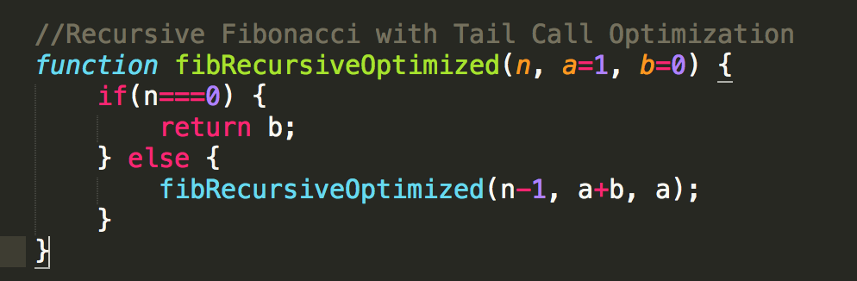
Tail-Optimized Recursion
fibRecursiveOptimized(5, 1, 0)
fibRecursiveOptimized(4, 1, 1)
fibRecursiveOptimized(3, 2, 1)
fibRecursiveOptimized(2, 3, 2)
fibRecursiveOptimized(1, 5, 3)
fibRecursiveOptimized(0, 8, 5)
-> Return 5 when you reach base case!

Slide 19
Now what happens with the stack?
For example, if we called fibRecursiveOptimized(5)
1
Func(5, 1, 0)
2
Func(4, 1, 1)
3
Func(3, 2, 1)
4
Func(2, 3, 2)
5
Func(1, 5, 3)
6
Func(0, 8, 5)

Slide 20
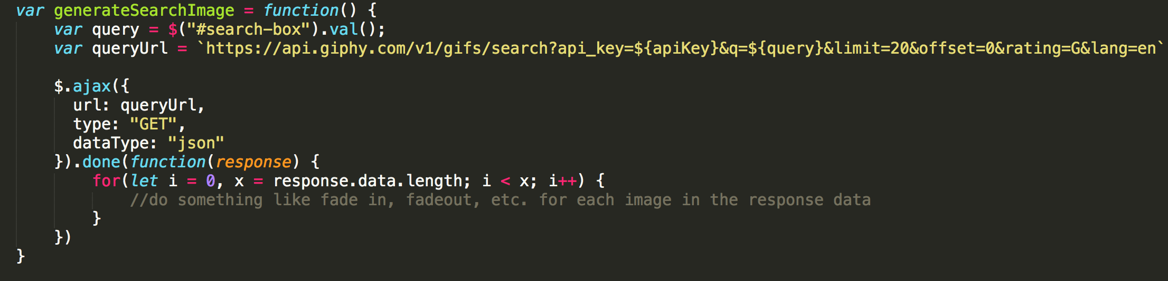
Uses of Recursion in JS

Slide 21
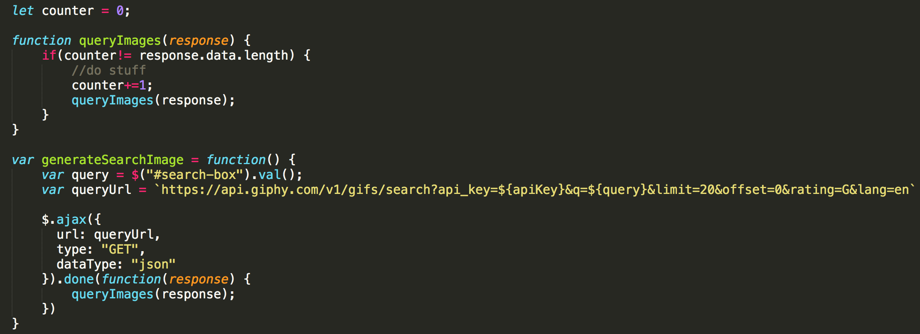
Uses of Recursion in JS

Slide 22
HOMEWORK
Palindromes – Given an input string, determine if it is a palindrome
Reverse String – Given an input string, return a reverse of the string
Make Change – Given an input value and an array [0, 0, 0, 0], return an array with values showing how many [quarters, dimes, nickels, pennies] should be used to efficiently get that value.
e.g. with an input of ( 68, [0,0,0,0] ), return [2,1,1,3] for 2 quarters, 1 dime, 1 nickel, and 3 pennies

Slide 23
MORE HOMEWORK
Flatten Array – Given an input array that might have nested arrays, return one array with all of the values in the nested array.
Input: [], return: []
Input: [1,2,3], return: [1,2,3]
Input: [1, [2, 3]], return: [1,2,3]
Input: [1, [[[2]]], 3], return: [1,2,3]

Slide 24
MORE HOMEWORK!!!!
Pretty Print – Given a complex object, print all of its properties and values (but make it pretty).
var o1 = {a:1, b:2}
var o2 = {a:1, b:2, c:{name:”Mo”}, d:4}
Pretty Print o1:
a:1
b:2
Pretty Print o2:
a:1
b:2
c:
name: Mo
d:4
Just focus on the indentations at each depth

Slide 25
Resources
www.leetcode.com
www.projecteuler.net

